Slide 1
CYBERSECURITY INTERNSHIP
WEEK 8 ASSIGNMENT
ADVANCED VAPT: ATTACK CHAIN & FULL EXPLOITATION PROJECT
Submitted by
Name: Deepashree.C
Role: Cybersecurity Intern
Week: Week 8
SIN: DG/SEPTEMBER/CYBER/254
Submitted to: DG Interns Hub
Topics covered:
o Attack Surface Mapping, Authentication &Application Flow Analysis
o Authorization and Access-Control Testing, Parameter Tampering
o Session Management Testing
o Burp Suite Request Interception and Analysis, Authorization Bypass Testing o Attack Chain Development
o Risk Assessment and Business Impact o Vulnerability Remediation

Slide 2
Introduction & Objectives
Introduction
Performed an authorized security assessment of Damn Vulnerable Web Application (DVWA) in a controlled virtual lab environment.
Utilized Kali Linux, Mozilla Firefox, and Burp Suite Community Edition to conduct web application security testing.
Evaluated authentication mechanisms, authorization controls, HTTP parameter manipulation, and session management.
Examined potential access control vulnerabilities and their impact on the confidentiality of user information.
Documented security weaknesses and identified appropriate mitigation strategies.
Objectives
Identify and analyze the application's attack surface and potential security risks.
Examine authentication workflows and understand the application's request-response mechanisms.
Evaluate authorization policies and identify weaknesses in access control enforcement.
Capture, inspect, and modify HTTP requests using Burp Suite Community Edition.
Analyze session ID generation and assess session management security.
Demonstrate a potential vulnerability exploitation chain within the authorized lab environment.
Recommend security best practices and remediation measures to strengthen the application's overall security.

Slide 3
Scope, Environment & Attack Surface
1. Testing Environment
Component | Details
Target Application | Damn Vulnerable Web Application (DVWA)
Target IP Address | 10.x.x.x (Local Lab IP)
Testing Platform | Kali Linux
Web Browser | Mozilla Firefox
Interception Proxy | Burp Suite Community Edition
Security Level | Medium
Testing Type | Authorized Local Web Application VAPT
Environment | Isolated Virtual Lab

Slide 4
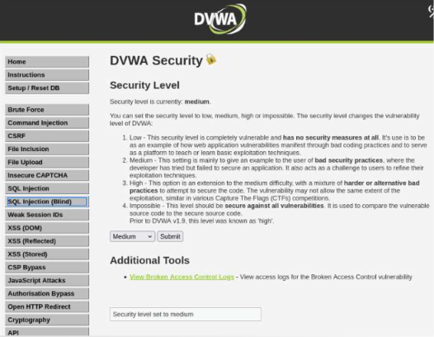
2. Attack Surface Identification
Login Module: Tested authentication security.
Access Control: Checked restricted pages and permissions.
User Data: Examined unauthorized data access.
Brute Force: Evaluated login protection.
SQL Injection: Tested input fields for vulnerabilities.
Session Management: Analyzed session ID security.
3. Testing Approach
Conducted manual testing in an authorized virtual lab using Burp Suite to inspect HTTP requests, test application security, identify vulnerabilities, and recommend remediation.

Slide 5
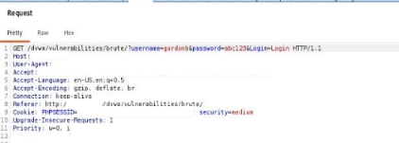
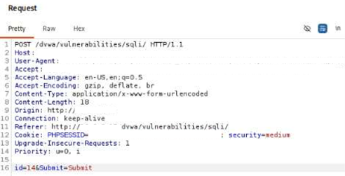
Authentication & Parameter Tampering
4. Authentication Testing
Logged in using the authorized test account gordonb.
Intercepted the login request with Burp Suite.
Examined the HTTP method and authentication parameters.
Limited testing to manual verification without automated password guessing.
5. Parameter Tampering
Intercepted a request from the SQL Injection module.
Modified the User ID parameter using Burp Suite Repeater.
Resubmitted the request and analyzed the server response.
Observed parameter manipulation behavior without claiming a confirmed IDOR vulnerability.
Fig 2: Brute Force Login Request Intercepted in
Burp Suite
Fig 3: User ID Parameter Modified Using Burp Suite

Slide 6

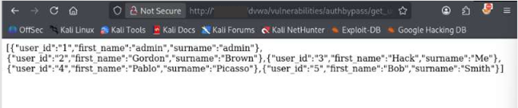
Authorization Bypass Testing
Testing Procedure
Logged in using the non-admin gordonb account.
Opened the Authorization Bypass module.
Tried to access the restricted page and saw an “Unauthorised” message.
Checked the backend endpoint using Burp Suite.
Observed that the endpoint returned multiple user records, including administrator information.
Key Observation
Although the page denied access, the backend endpoint returned user information. This indicates a possible access control issue.
Impact
A normal user could potentially view information belonging to other users without permission.
Recommendation
Add proper authorization checks on the server and ensure that only authorized users can access restricted information.
Fig 4: Restricted Authorisation Bypass Page Displaying an
Unauthorised Message
Fig 5: JSON Response Containing User Information

Slide 7
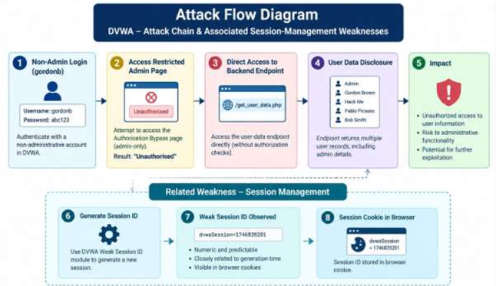
Attack Chain Development
Demonstrated Attack Chain
Step 1: Logged in using a non-administrative gordonb account.
Step 2: Tried to open the restricted page.
Step 3: The application displayed an “Unauthorised” message.
Step 4: Inspected the backend endpoint using Burp Suite.
Step 5: Found that the endpoint returned multiple user records, including administrator information
Attack Chain Impact
Demonstrated possible unauthorized access to user information.
Identified a weakness in backend authorization checks.
Showed that frontend restrictions did not fully protect the backend endpoint.
Account takeover or administrative access was not demonstrated.
Fig 6: Attack Flow Diagram Illustrating the
Authorization Weakness

Slide 8
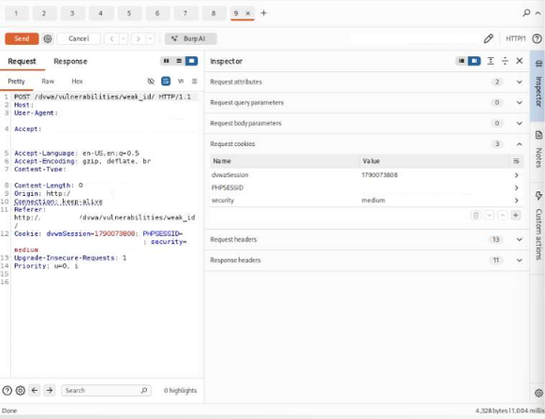
Key Findings & Risk Impact
Finding 1: Improper Authorization
Severity: High
The backend endpoint exposed multiple user records to a non-admin user.
This indicates a potential access-control weakness that may lead to unauthorized data disclosure.
Finding 2: Weak Session ID Generation
Severity: Medium
Session IDs were numeric and appeared related to generation time.
Session hijacking was not demonstrated, but further testing is needed to verify predictability.
Finding 3: Potential IDOR Vulnerability
Severity: Medium
The User ID parameter was modified using Burp Suite Repeater.
Unauthorized object access was not confirmed and requires further validation.
Potential Business Impact
Unauthorized exposure of user information.
Privacy and data confidentiality risks.
Increased risk of targeted attacks.
Loss of user trust and reputation.
Potential regulatory and compliance concerns.
Fig 7: Weak Session ID Values Observed During Testing

Slide 9
Remediation & Conclusion
Remediation
Enforce server-side authorization checks on all sensitive endpoints.
Verify user permissions before providing restricted data.
Generate secure, unpredictable session IDs and regenerate them after login.
Validate user-controlled parameters on the server.
Apply rate limiting and monitor suspicious authentication activity.
Conduct independent security testing of backend APIs.
Conclusion
Conducted an authorized VAPT assessment of DVWA in a controlled lab environment.
Evaluated authentication, authorization, session management, and parameter handling.
Identified unauthorized exposure of user records through a backend endpoint.
Observed potential weaknesses in session ID generation and parameter tampering.
Proposed security improvements to strengthen access controls and reduce potential risks.

